Slide 1
Computational Systems Biology for Medical Applications Summary of Approach to Modeling Game
Joseph L. Hellerstein*
Herbert Sauro**
*eScience Institute, Computer Science & Engineering
**BioEngineering

Slide 2
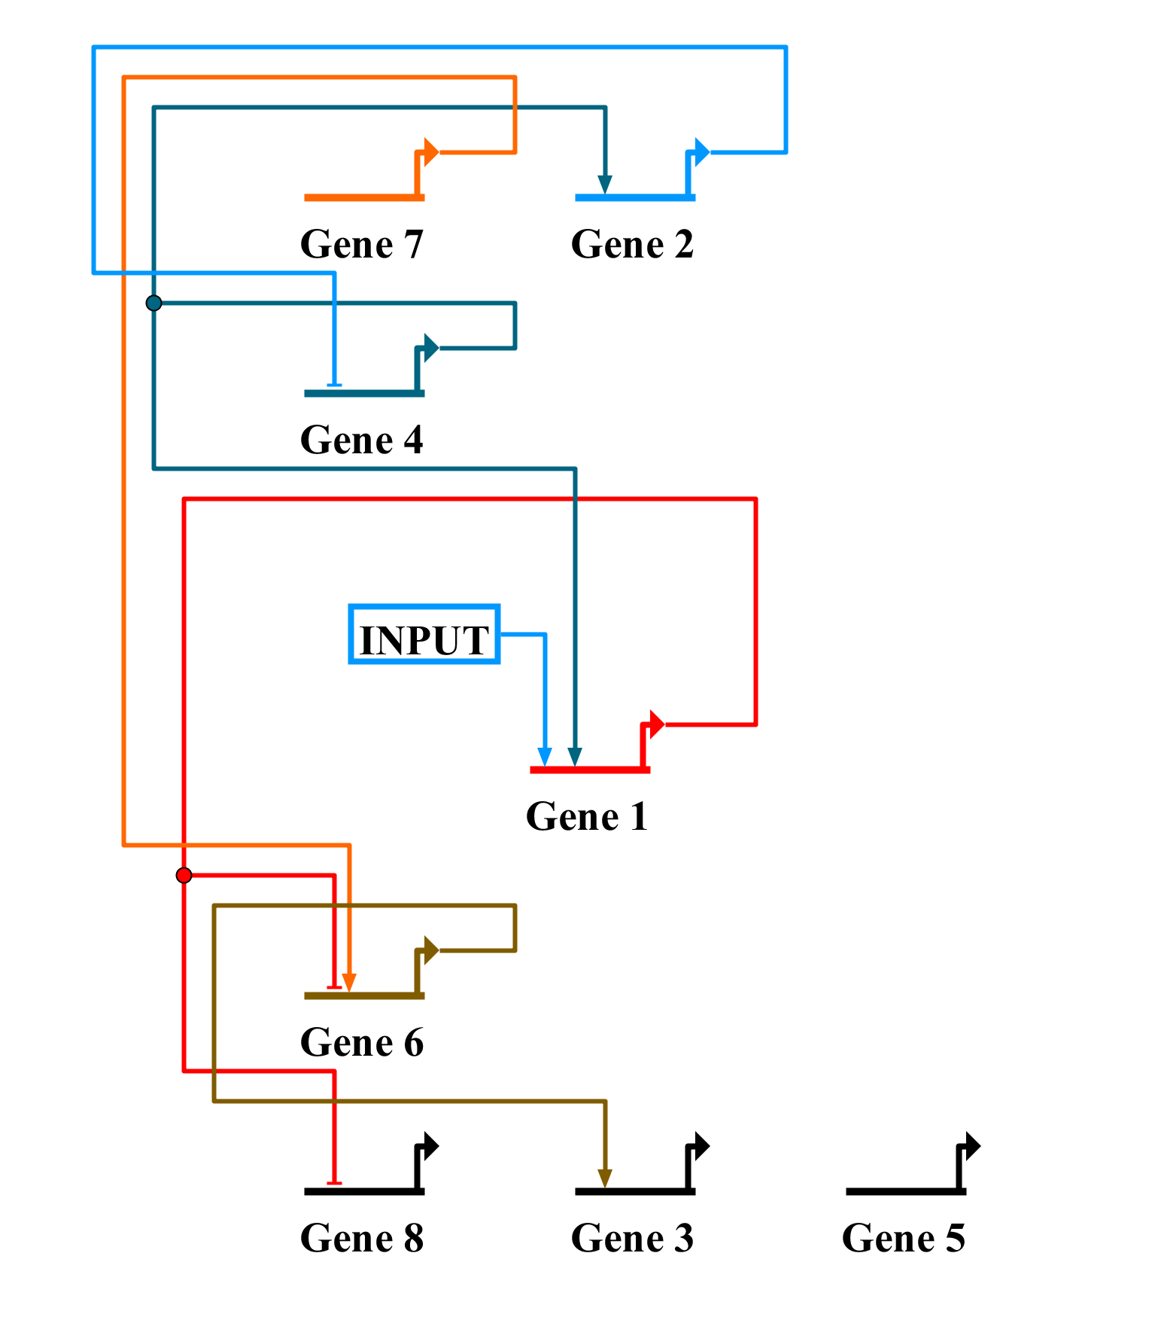
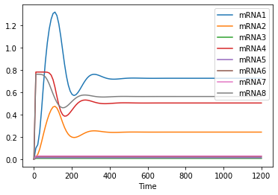
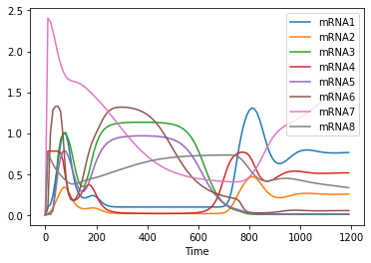
Modeling Game
Simulation of Base Model
mRNA Measurements
Now what?

Slide 3
Problem Statement
Discover the modeling game GRN using
wild type mRNA data (protein data or no knockouts)
laptop (no supercomputer)
Dual problem
Use protein data instead of mRNA

Slide 4
Challenges
Combinatorics of possible networks (within the game constraints)
17 possibilities for each TF (8 activate + 8 inhibit + None)
9 ”absent” TFs
17⁹ ~12T
Computation time due to
Number of parameters to estimate and simulation length

Slide 5
Techniques
Qualitative analysis to form hypotheses about network connections
Limits search space
Computation to select best hypotheses
But fitting even 10 parameters takes a LONG time.

Slide 6
Core Idea
Estimate protein concentrations from mRNA
numerical integration of the protein kinetics equations
Decouple gene kinetics by using estimated values of protein concentrations
Reduces the combinatorics to 17*9 network evaluations from 17⁹ network evaluations.
Still need qualitative approach since this is too much to “brute force” on a laptop.

Slide 7
Workflow
Estimate proteins from observations of mRNA
For each gene
Use qualitative analysis to select candidate transcription factors
Evaluate using numerical integration and the estimated protein data
Select the best set of transcription factors and record the parameter estimates
Use the above parameter estimates as a starting point for a full optimization of the identified GRN.

Slide 8
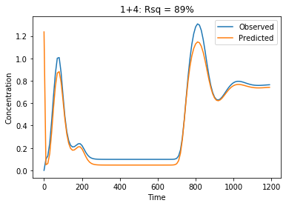
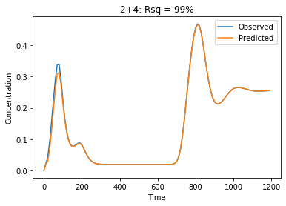
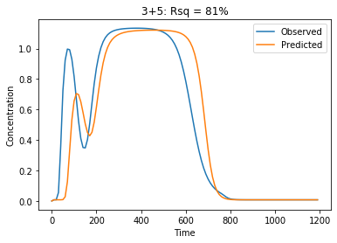
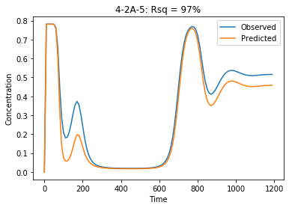
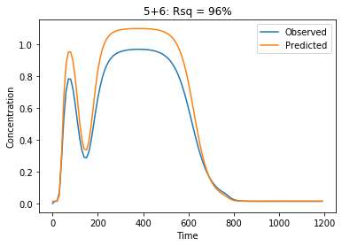
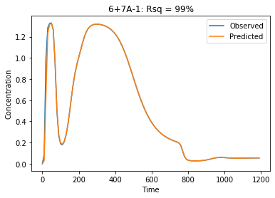
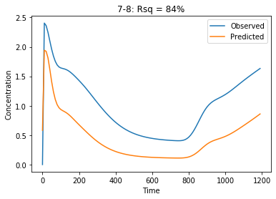
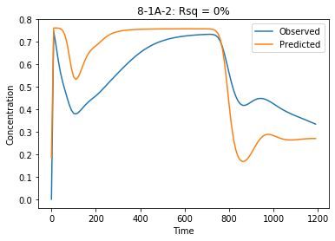
1
2
3

